Slide 1

Test Automation
Vasilis Petrou
Test Automation Leader
Coding Hive Patras 2019 | Coding School
STATION 8

Slide 2
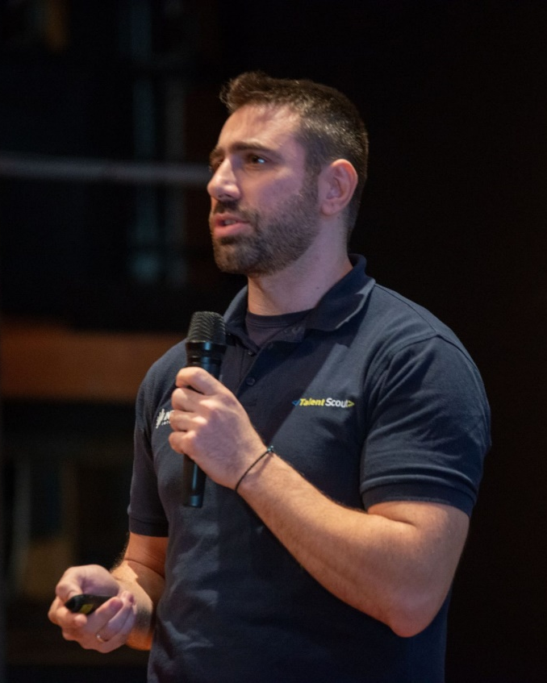
About me
Test Automation Leader @ Intrasoft International | 4 years
More than 15 years experience in Software Engineering
Thessaloniki Software Testing & QA Meetup Co-organizer
Volunteer Speaker on Test Automation to Universities, Colleges, Meetups & Conferences
Vasilis Petrou
https://www.linkedin.com/in/vpetrou
Vasilis PETROU | Test Automation Leader | INTRASOFT International

Slide 3

Agenda
Introduction to Software Testing & Test Automation
Analysis of the Application Under Test (AUT)
UI Testing with Java and Selenium WebDriver
Part I: Basic Implementation
Part II: Packaging & Refactoring (Page Object Model)
Web Service Testing with SoapUI
Part I: Basic Implementation
Part II: Packaging & Refactoring (SoapUI & Maven Integration)
Performance Testing with JMeter
Part I: Basic Implementation
Part II: Packaging & Refactoring (JMeter & Maven Integration)
Test Design Specifications Documentation (TDS)
Vasilis PETROU | Test Automation Leader | INTRASOFT International

Slide 4
Theory
Let’s define some terms

Slide 5

What is Software Testing?
Software Testing is a process in Software Development Lifecycle (SDLC), where we check whether the actual results of a software match the expected results
Vasilis PETROU | Test Automation Leader | INTRASOFT International

Slide 6

And why we talk about testing in developers’ event?
An application can be tested
manually & automatically
To test an application automatically,
we must have programming skills
Vasilis PETROU | Test Automation Leader | INTRASOFT International

Slide 7



Programming skills to test? how this came about?
past
present
future
AI in Automated Testing
Machine Learning in Automated Testing
Visual Testing
Open Source Libraries to create Automated Tests writing code
Test Automation Coding Patterns to write better maintainable code
Expensive Tools with Record & Play feature
Spaghetti Code in background
Vasilis PETROU | Test Automation Leader | INTRASOFT International

Slide 8

What is Test Automation?
The use of another program or tool
to execute automatically the tests
and report the results
Vasilis PETROU | Test Automation Leader | INTRASOFT International

Slide 9
When do we need Test Automation?
Test automation is needed when the application demands many test executions
many versions
cross-platform or cross-browser
many combinations of data and rules
Vasilis PETROU | Test Automation Leader | INTRASOFT International

Slide 10
What is the Job Title related to Test Automation?
Test Automation Engineer
based on ISTQB (International Organization in Software Testing)
www.istqb.org
Alternatively the Job Title can also be:
Software Engineer in Test
QA Engineer
QA Automation Engineer
Vasilis PETROU | Test Automation Leader | INTRASOFT International

Slide 11
What is the role of a Test Automation Engineer?
learn application’s business
analyze and write test cases
design and write test automation scripts
use test automation frameworks
investigate issues in software as a result of testing
work with analysts and software engineers to find solutions
Vasilis PETROU | Test Automation Leader | INTRASOFT International

Slide 12
Some necessary skills of a Test Automation Engineer?
coding
ability to decide what not to be automated
analytical thinking
willingness for manual testing when required
ability to analyze issues and report them properly
Vasilis PETROU | Test Automation Leader | INTRASOFT International

Slide 13
Practice
Let’s see some code

Slide 14
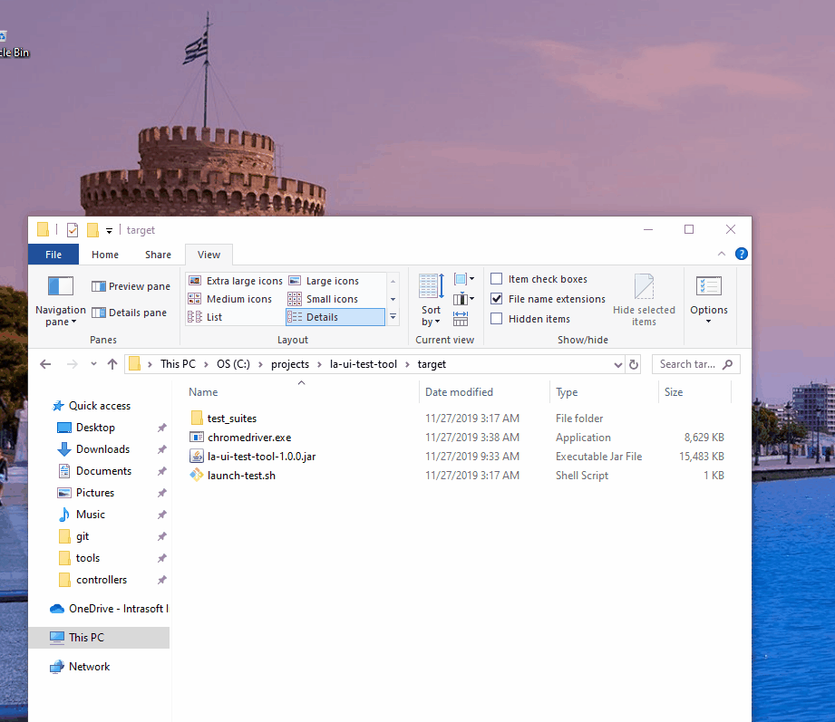
How we will deliver the Test Automation Projects?
tests will be executed with just a simple click…
Vasilis PETROU | Test Automation Leader | INTRASOFT International

Slide 15
How we will test the UI?
To test the
UI of our Web Application
we will use:
Java
Maven
Selenium WebDriver
TestNG
Vasilis PETROU | Test Automation Leader | INTRASOFT International

Slide 16
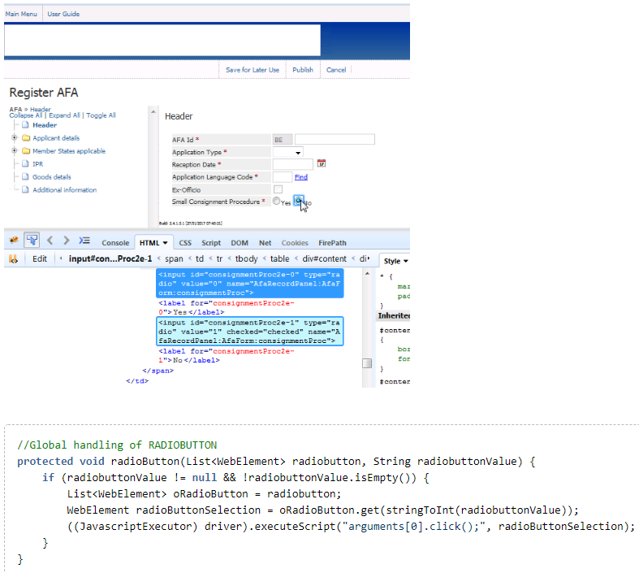
How we accelerate the implementation of the Test Automation Projects?
To accelerate our implementation
we will create common methods
to be used in many cases.
Vasilis PETROU | Test Automation Leader | INTRASOFT International

Slide 17
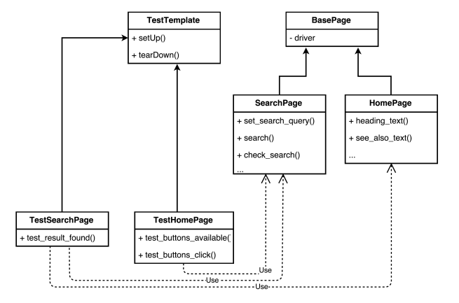
How we achieve better maintenance for our Test Automation Projects?
We will use Page Object Model design pattern
Vasilis PETROU | Test Automation Leader | INTRASOFT International

Slide 18
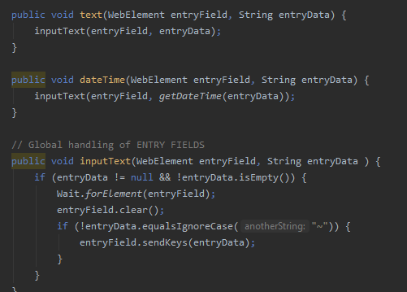
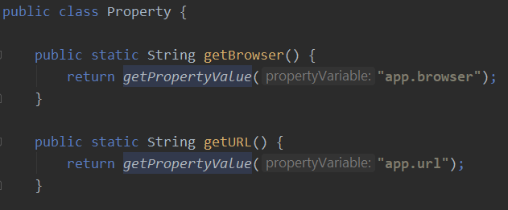
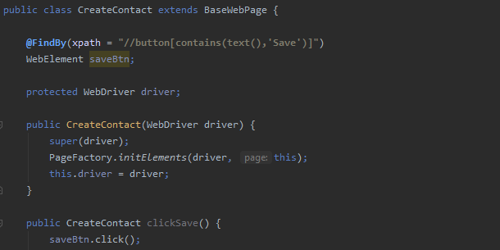
How we apply Object Oriented Principles to our Test Automation Projects?
We will use Object Oriented Programming principals
polymorphism
inheritance
&
abstraction
encapsulation
Vasilis PETROU | Test Automation Leader | INTRASOFT International

Slide 19
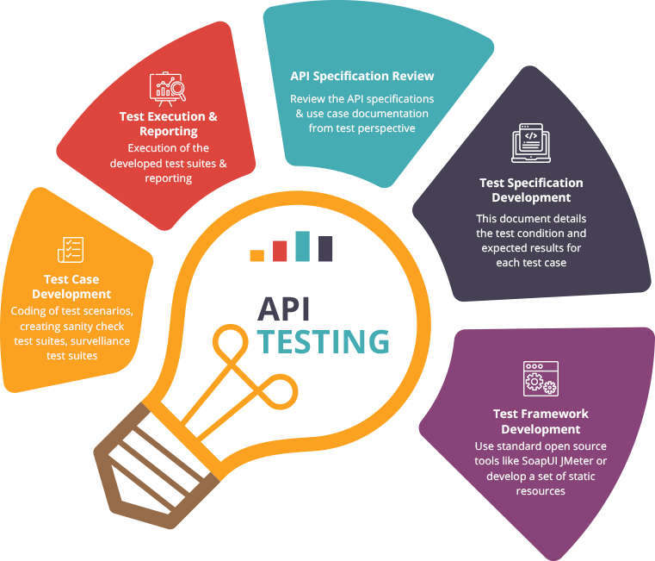
How we will test the Web Services?
To test the
RESTfull Web Services of our Web Application
we will use:
SoapUI
Apache Groovy
Vasilis PETROU | Test Automation Leader | INTRASOFT International

Slide 20

How we will test the Performance?
To test the
Performance of our Web Application
we will use:
JMeter
Vasilis PETROU | Test Automation Leader | INTRASOFT International

Slide 21
Resources
Let’s find reading material

Slide 22
What to download?
Software Testing
ISTQB http://www.istqb.org
Test Automation Playground for Practice
Docker https://www.docker.com/get-started requires Windows 10 or MacOS or Linux
GitHub https://github.com/Intrasoft-International/STATION-8
UI Test Automation
Java https://www.java.com/ES/download
Maven https://maven.apache.org/download.cgi
Selenium ChromeDriver https://chromedriver.chromium.org/downloads
Web Services Test Automation
SmartBear SoapUI https://www.soapui.org
Apache Jmeter https://jmeter.apache.org
Performance Test Automation
IntelliJ IDEA CE https://www.jetbrains.com/idea/download
Vasilis PETROU | Test Automation Leader | INTRASOFT International

Slide 23




Where to find me?
https://github.com/vpetrou Test Automation Playgrounds to practice on GUI & API Automated Testing
https://www.linkedin.com/in/vpetrou
vpetrou@intrasoft-intl.com
petrou82@gmail.com
https://www.meetup.com/Thessaloniki-Software-Testing-and-QA
Vasilis PETROU | Test Automation Leader | INTRASOFT International

Slide 24


Thank you
Let’s start our journey on test automation
Follow us

